Slide 1
Williston Basin Oil and Gas Emission Inventory: Midterm Year Activity Forecasts
ENVIRON International Corporation
April 16, 2013

Slide 2
Outline
Activity forecasting method
Activity forecasts by basin subareas
Oil and gas takeaway infrastructure

Slide 3
Forecasting Method: Overview
Primary Data Sources:
IHS Oil and Gas Database (historical data)
Operator input (drilling forecasts, well decline)
Secondary sources for validation
2012 Bentek Study (gas and oil production)

Slide 4
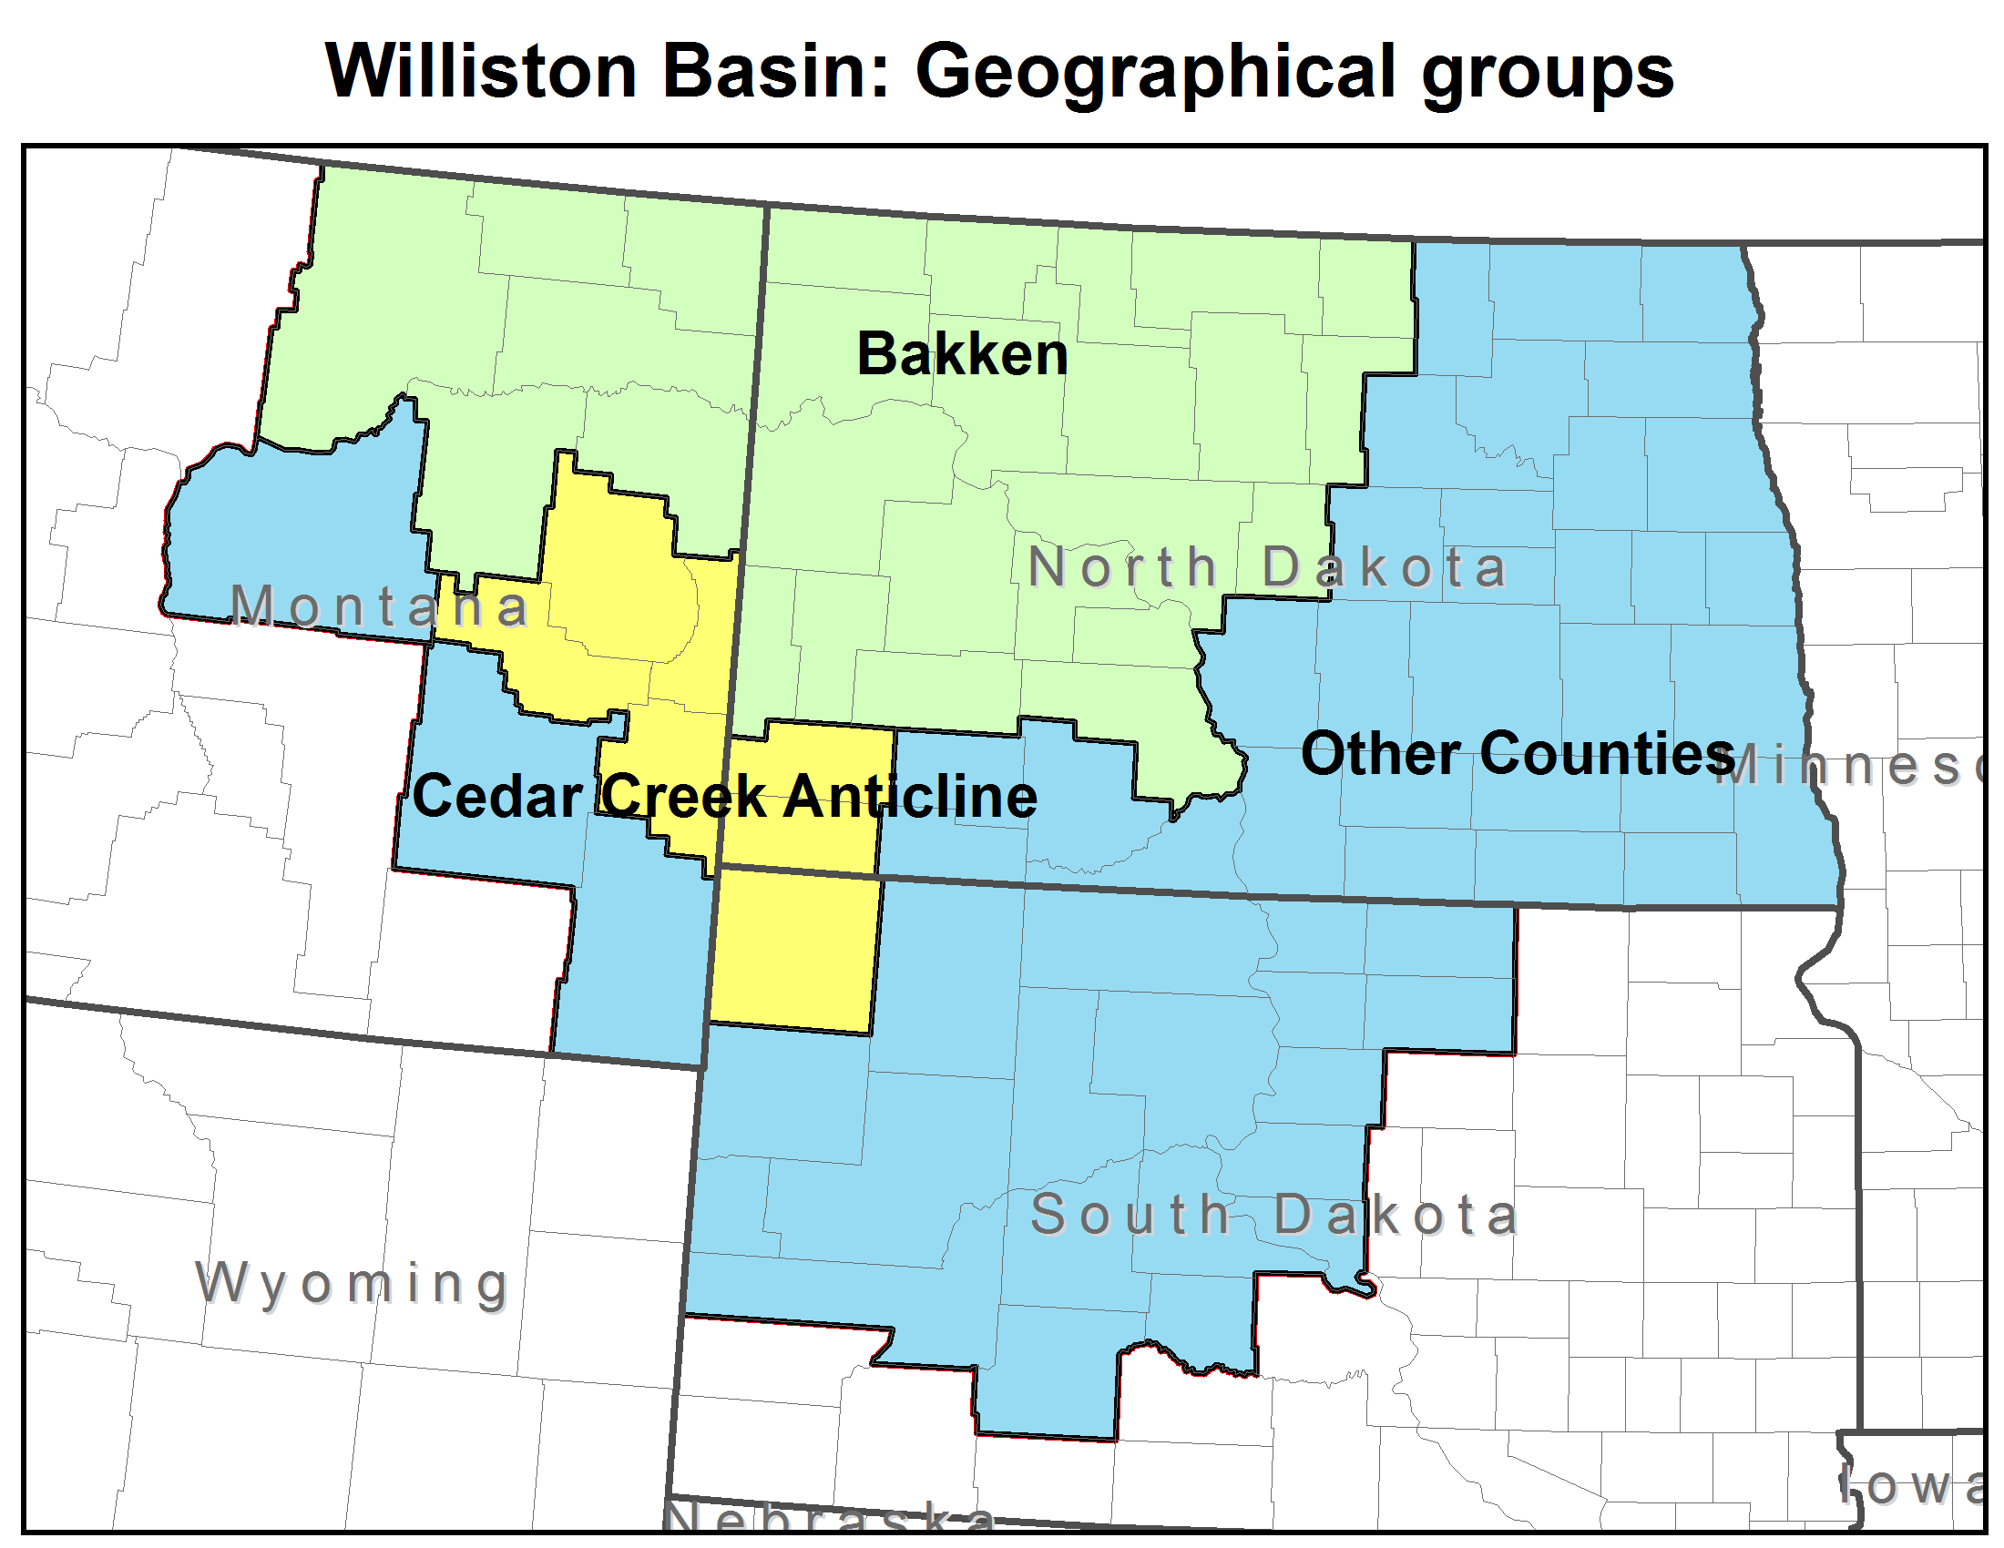
Forecasting Method: Basin Subareas

Slide 5
Forecasting Method: Flow Chart
Future Years Drilling Schedule (2012 – 2015)
Well Decline Curve
2011 Production (source: IHS database)
Midterm Year Production from Wells Added After Base Year 2011
Midterm Year Production from Wells in Operation in Base Year 2011 and Earlier
Midterm Year Production from All Wells

Slide 6
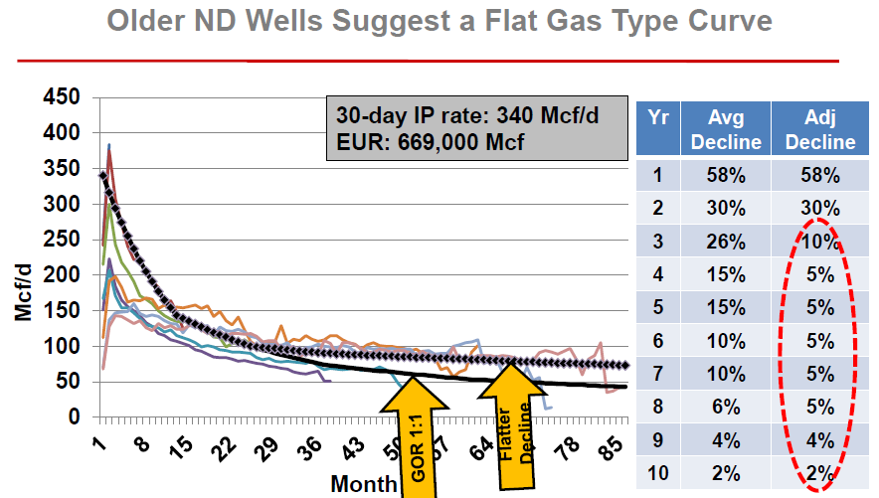
Sample Oil Well Decline Curve
Source: Williston Basin: Greasing the Gears for Growth in North Dakota. NDPA/NDIC Study. BENTEK Energy. http://ndpipelines.files.wordpress.com/2012/07/bentek_ogrp-slides-8-14-2012.pdf

Slide 7
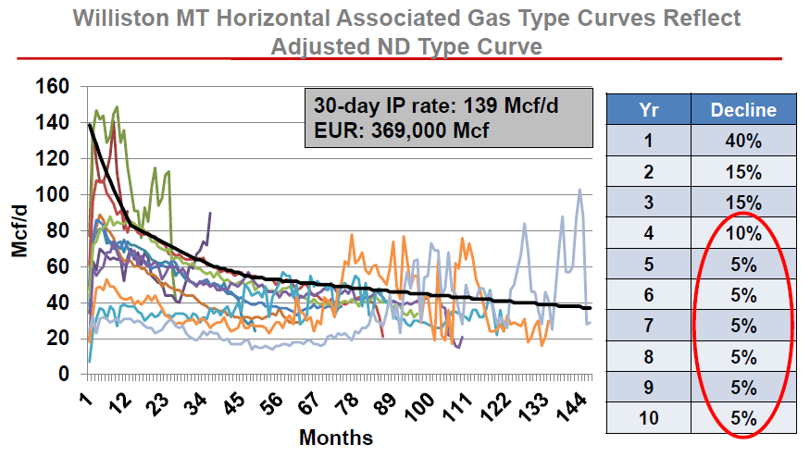
Sample Gas Well Decline Curve
Source: Williston Basin: Greasing the Gears for Growth in North Dakota. NDPA/NDIC Study. BENTEK Energy. http://ndpipelines.files.wordpress.com/2012/07/bentek_ogrp-slides-8-14-2012.pdf

Slide 8
Activity Forecasts By Subarea
Drilling
Oil well spuds
Gas well spuds
Active well counts
Oil wells
Gas wells
Liquids Production
Crude oil
Condensate
Gas Production
Associated gas
Natural gas

Slide 9
2011 Subarea Contributions

Slide 10
Bakken Subarea Drilling
Oil well spuds

Slide 11
Bakken Subarea Drilling
Gas well spuds

Slide 12
Bakken Subarea Active Wells
Oil Wells

Slide 13
Bakken Subarea Active Wells
Gas Wells

Slide 14
Bakken Subarea Crude Oil Production
Oil Wells

Slide 15
Bakken Subarea Condensate Production
Gas Wells

Slide 16
Bakken Subarea Associated Gas Production
Oil wells

Slide 17
Bakken Subarea Natural Gas Production
Gas wells

Slide 18
Cedar Creek Anticline Drilling
Oil well spuds

Slide 19
Cedar Creek Anticline Drilling
Gas well spuds

Slide 20
Cedar Creek Anticline Number of Active Wells
Oil Wells

Slide 21
Cedar Creek Anticline Number of Active Wells
Gas Wells

Slide 22
Cedar Creek Anticline Crude Oil Production
Oil Wells

Slide 23
Cedar Creek Anticline Condensate Production
Gas Wells

Slide 24
Cedar Creek Anticline Associated Gas Production
Oil wells

Slide 25
Cedar Creek Anticline Natural Gas Production
Gas wells

Slide 26
All Remaining Counties Drilling
Oil well spuds

Slide 27
All Remaining Counties Drilling
Gas well spuds

Slide 28
All Remaining Counties Number of Active Wells
Oil Wells

Slide 29
All Remaining Counties Number of Active Wells
Gas Wells

Slide 30
All Remaining Counties Crude Oil Production
Oil Wells

Slide 31
All Remaining Counties Condensate Production
Gas Wells

Slide 32
All Remaining Counties Associated Gas Production
Oil wells

Slide 33
All Remaining Counties Natural Gas Production
Gas wells

Slide 34
Infrastructure Development: Casinghead Gas Flaring
Data from 2009 to Jan 2013 from ND DMR https://www.dmr.nd.gov/oilgas/stats/Gas1990ToPresent.pdf

Slide 35
Infrastructure Development: Oil
Direct to pipeline infrastructure?

Slide 36
Infrastructure Development: Oil Pipeline vs. Rail
source: NDPA http://northdakotapipelines.com/oil-transportation-table/

